Slide 1






MySQL
Project
Restaurant Business:
Menu, Orders, and Sales

Slide 2

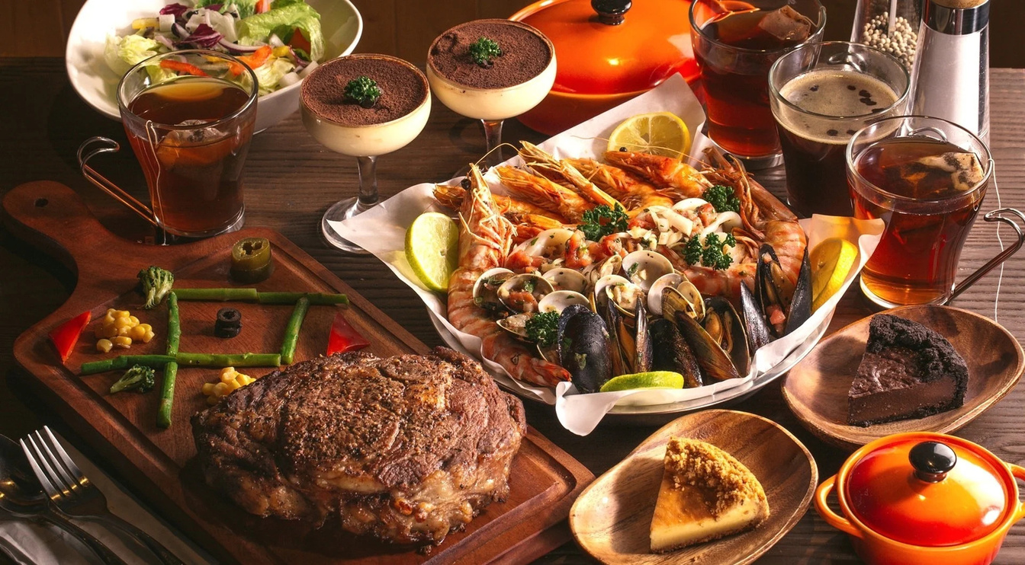

Introduction
This dataset contains restaurant transaction data, including menu details and order records. It helps analyze sales trends, popular items, and peak ordering times. Ideal for business insights, pricing strategies, and customer preferences analysis.

Slide 3
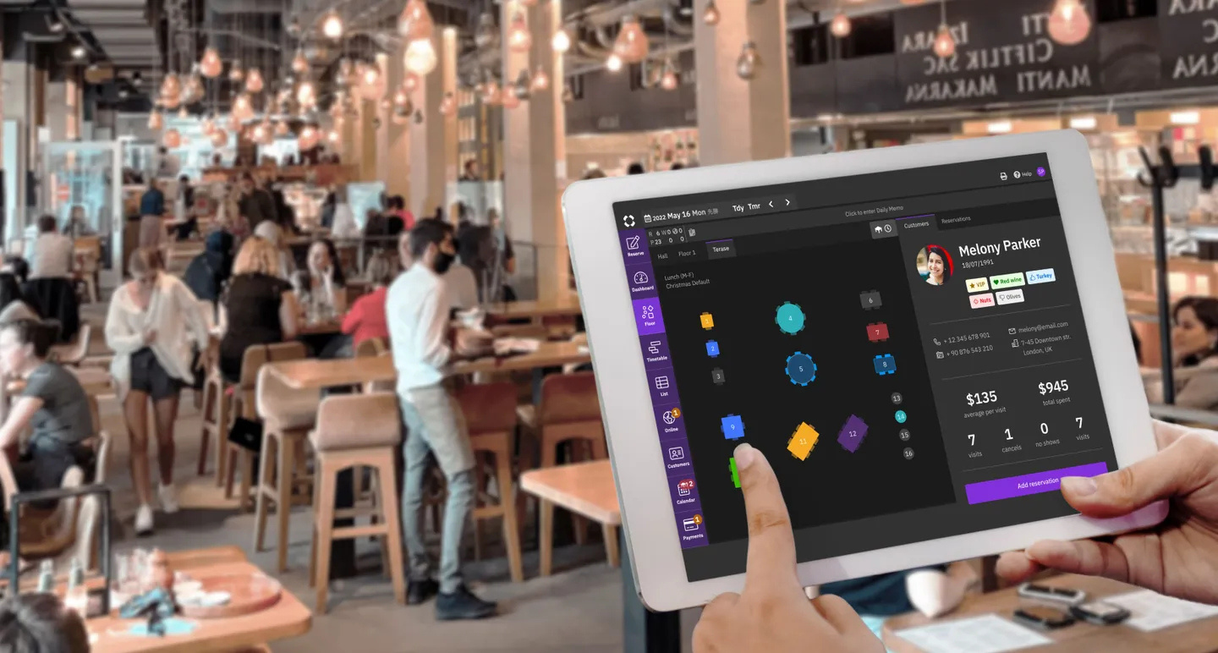

Objective :-
The objective of this data is to analyze restaurant sales, customer ordering patterns, and menu performance. Key goals include:
Sales Analysis – Track revenue trends based on menu items and order frequency.
Customer Preferences – Identify the most popular food items and categories.
Peak Order Times – Determine high-traffic hours for better staffing and inventory management.
Menu Optimization – Assess item performance to adjust pricing or promotions.
Business Decision Making – Provide insights for restaurant growth and operational efficiency.

Slide 4
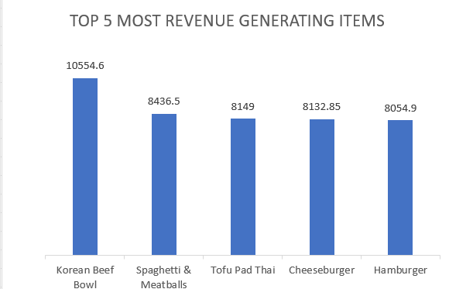
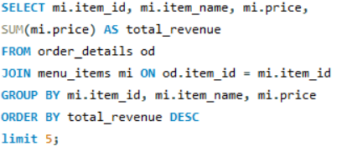
-- Q1. Top 5 Revenue generating items. --
The bar chart displays the top five highest revenue-generating food items. The Korean Beef Bowl leads with the highest revenue at 10,554.6, followed by Spaghetti & Meatballs (8,436.5). The other top items include Tofu Pad Thai (8,149), Cheeseburger (8,132.85), and Hamburger (8,054.9). The revenue values indicate that these dishes are among the most profitable on the menu.

Slide 5
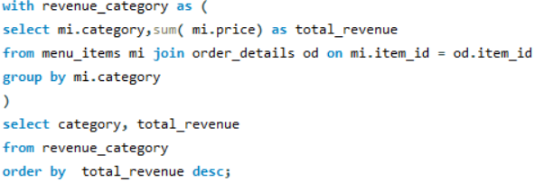
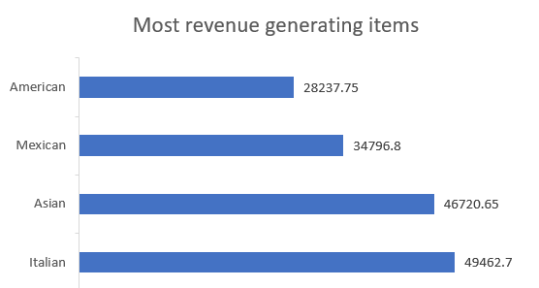
Q2. Which category generate the highest revenue ?
The bar chart shows the revenue generated by different cuisine categories. Italian cuisine leads with the highest revenue at 49,462.7, followed by Asian cuisine at 46,720.65. Mexican cuisine comes next with 34,796.8, while American cuisine generates the least revenue among the four at 28,237.75. This suggests that Italian and Asian cuisines are the most profitable categories.

Slide 6
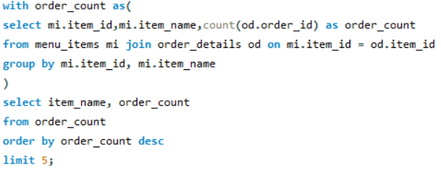
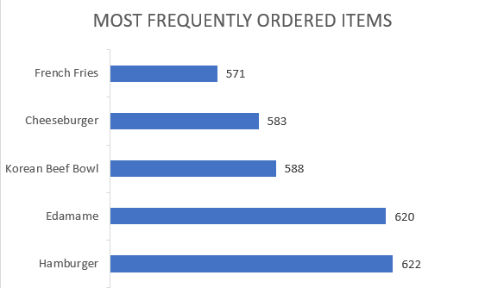
Q3. Which items are the most frequently ordered ?
The bar chart displays the most frequently ordered food items. Hamburger leads with 622 orders, followed closely by Edamame at 620 orders. Other popular items include Korean Beef Bowl (588 orders), Cheeseburger (583 orders), and French Fries (571 orders). This suggests that burgers and side items are among the most in-demand menu choices.

Slide 7
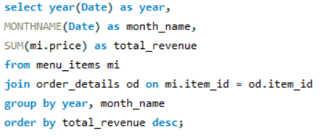
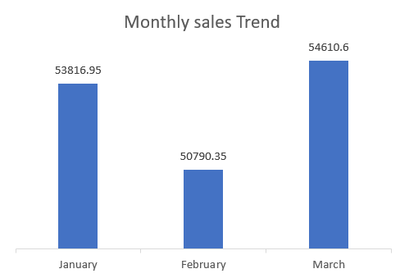
Q4. What are sales trend on the basis of month in a year of restaurant ?
The bar chart illustrates the monthly sales trend for January, February, and March. January recorded sales of 53,816.95, followed by a drop in February to 50,790.35. However, sales rebounded in March to 54,610.6, making it the highest-performing month. This suggests a fluctuating sales pattern, with a dip in February but an overall upward trend.

Slide 8
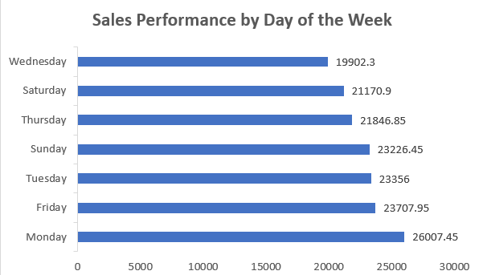
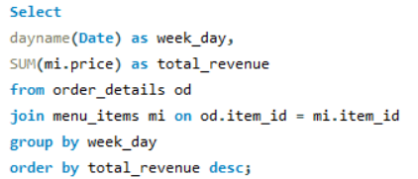
Q5. Which day of week has most no of orders ?
Monday had the highest sales (26,007.45), while Wednesday had the lowest (19,902.3). Sales peak at the start and end of the week, with moderate performance on other days.

Slide 9
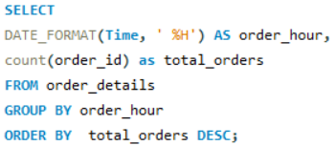
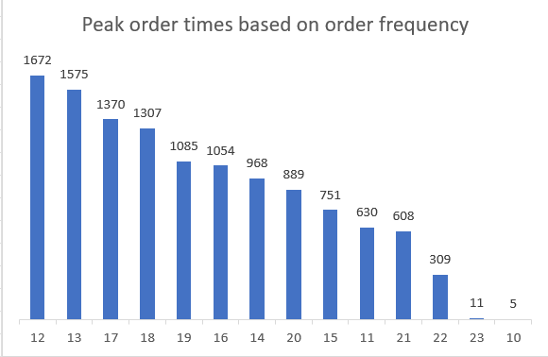
Q6. What are the peak order times based on order frequency?
Peak order times occur around 12 PM (1672 orders) and gradually decline throughout the day. The lowest order frequencies are at 10 PM (11 orders) and 11 PM (5 orders), indicating a sharp drop in demand late at night.

Slide 10

Recommendations:
Focus on promoting best-sellers (Hamburger, Edamame, Korean Beef Bowl) through combos and upselling. Optimize pricing & menu by reviewing underperforming items. Introduce time-based promotions to boost sales during off-peak hours. Expand popular categories to attract more customers.
Explain more about some global solutions to save the arctic here.
Explain more about some global solutions to save the arctic here.

Slide 11



THANK YOU !
for watching this presentation
Avishek Paswan
7029689216
paswanaman43@gmail.com

